Slide 1
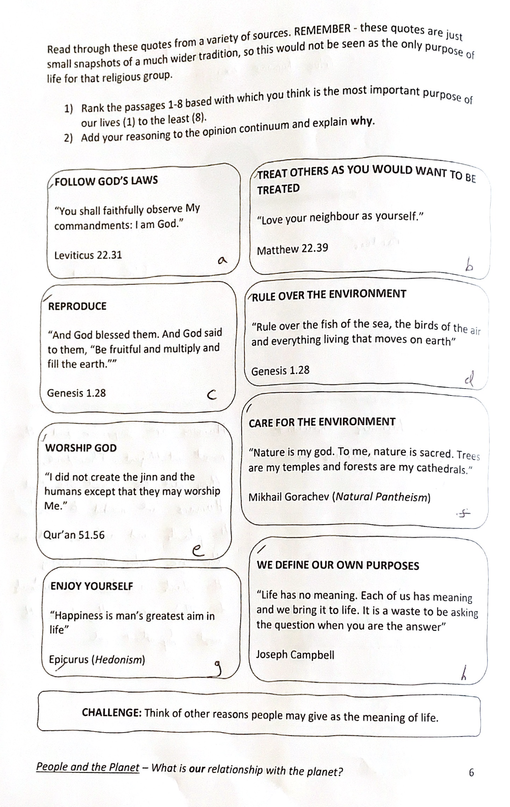
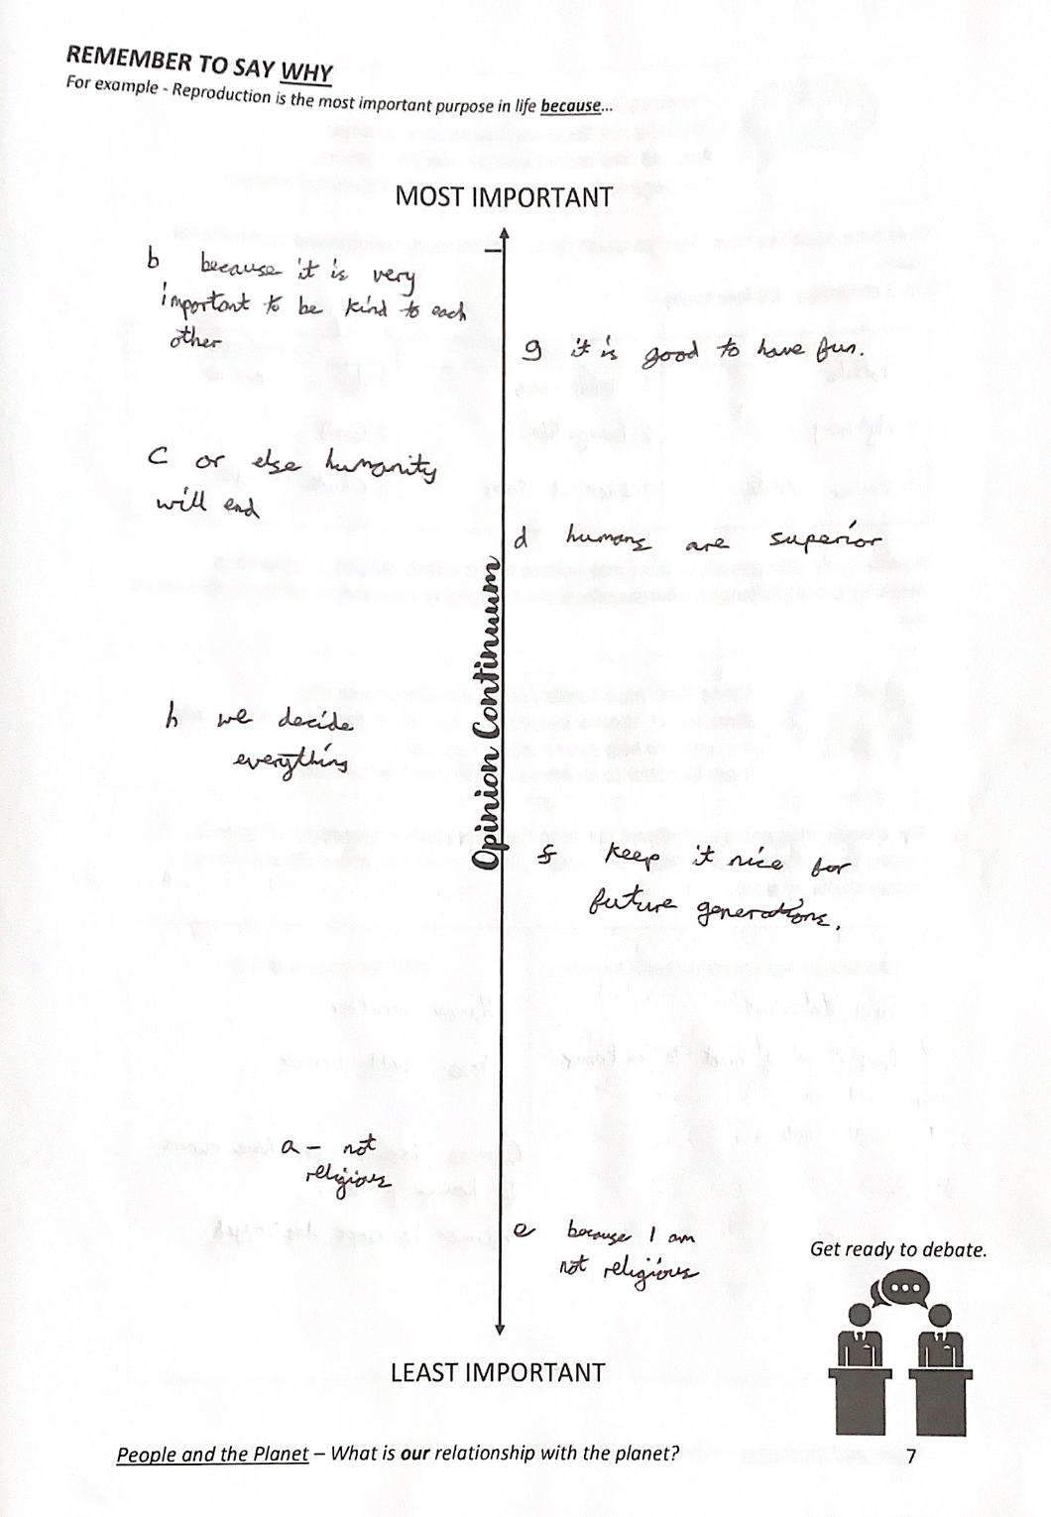
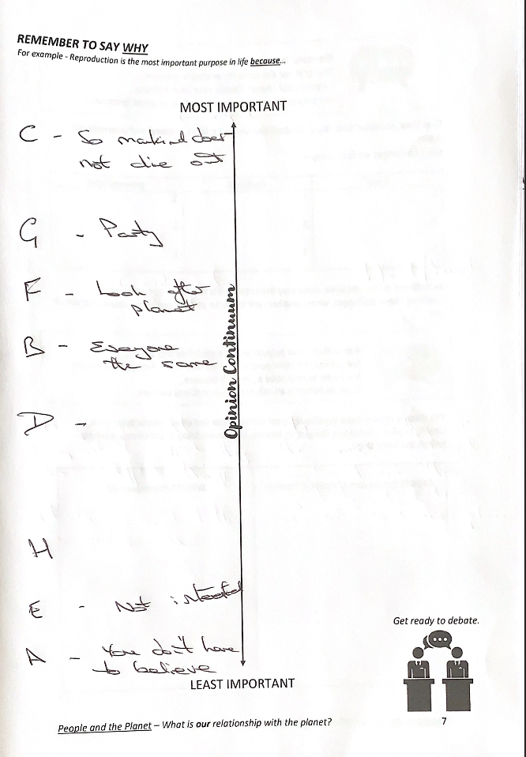
Only 1 student in our class did not place fun within the top 4 of their opinion continuum, which was then above caring for the environment. When discussing this, many did think that it is important to care for the environment but would not want to then compromise on their own lifestyle.
Factors relating to religion were usually at one end of the spectrum or the other based upon individual belief.

Slide 2
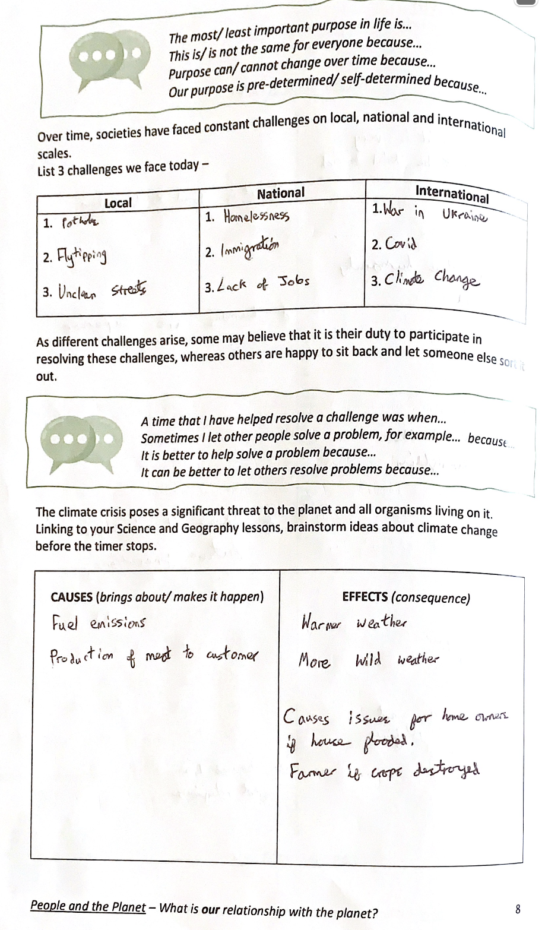
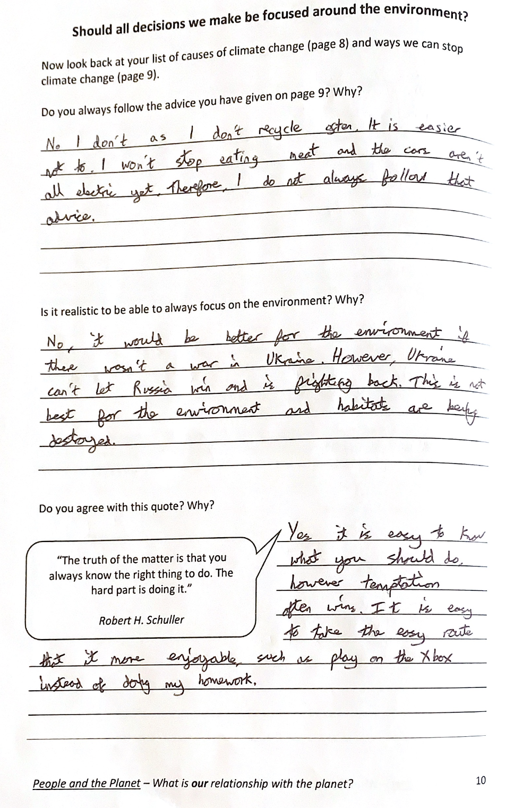
The aim of this task was to show students that they are all aware of the causes and effects of climate change (page 8).
On page 9, students were asked to create a make a poster displaying ways that we can help stop climate change. The criteria was to include practical advice and why it is our responsibility to care for the environment.
Pages 8 and 9 were completed prior to turning over to page 10. this was a lightbulb moment for many students as it provided a chance to reflect on why they are not following their own advice.

Slide 3
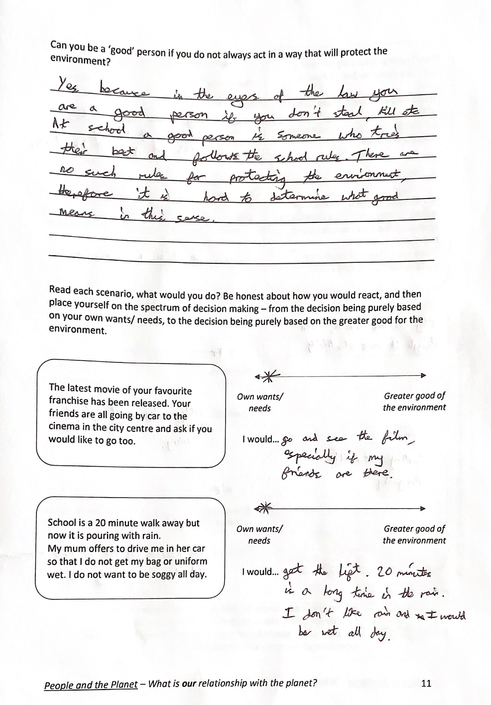
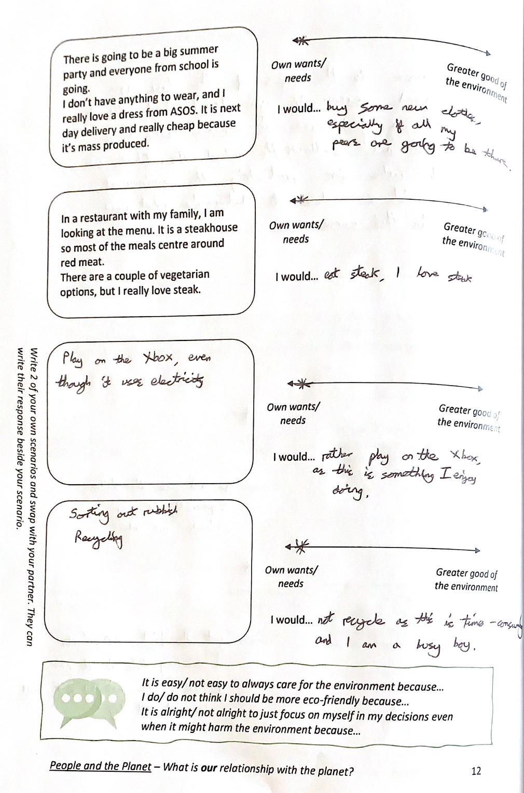
The first question on page 11 takes the self-reflection one step further. It centres around morality and whether you can be ‘good’ if you do not care for the environment.
When completing pages 8 and 9, students were quick to criticise fossil fuels, etc. so this question allowed them to look inwards.
The scenario-based tasks provided another chance for reflection and allowed students to enter the narrative, as these were relatable situations. The majority of responses were favouring own wants/ needs.
The aim of this topic is not to guilt trip the children, but to allow them to see themselves within the climate emergency narrative, and how everyone needs to work together to overcome it.

Slide 4
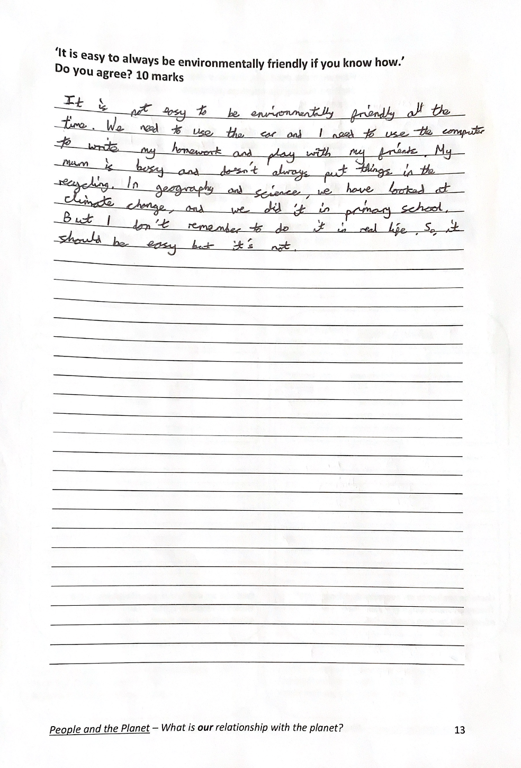
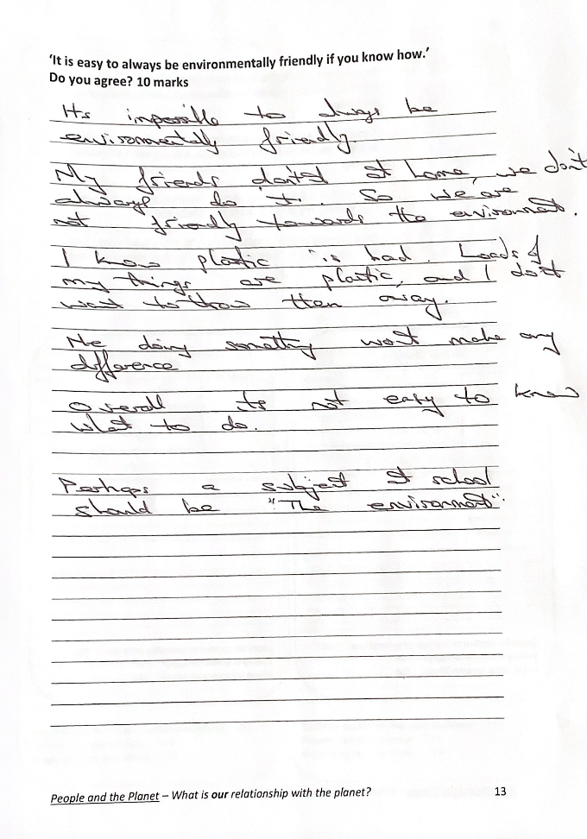
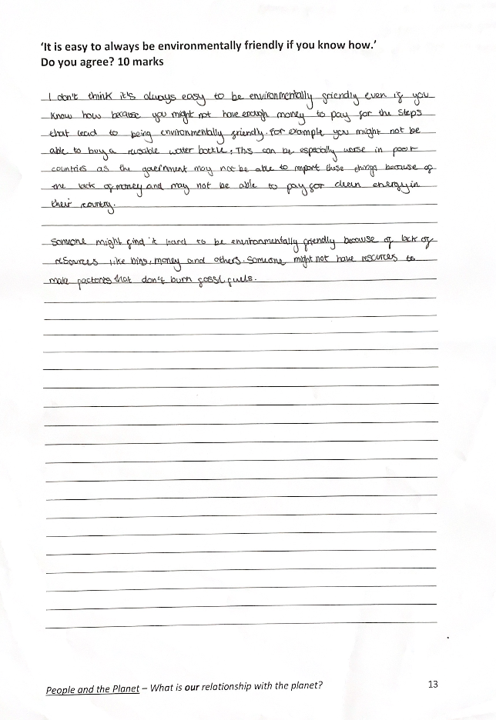
Page 13 allows students to complete a silent piece of extended writing. They can then gather their thoughts from their self-reflection as part of their response.
Students were all able to create a poster (page 10) telling others what they need to do to stop climate change but did not find it as easy to then reflect on their own behaviour if they were not following their own advice.

Slide 5
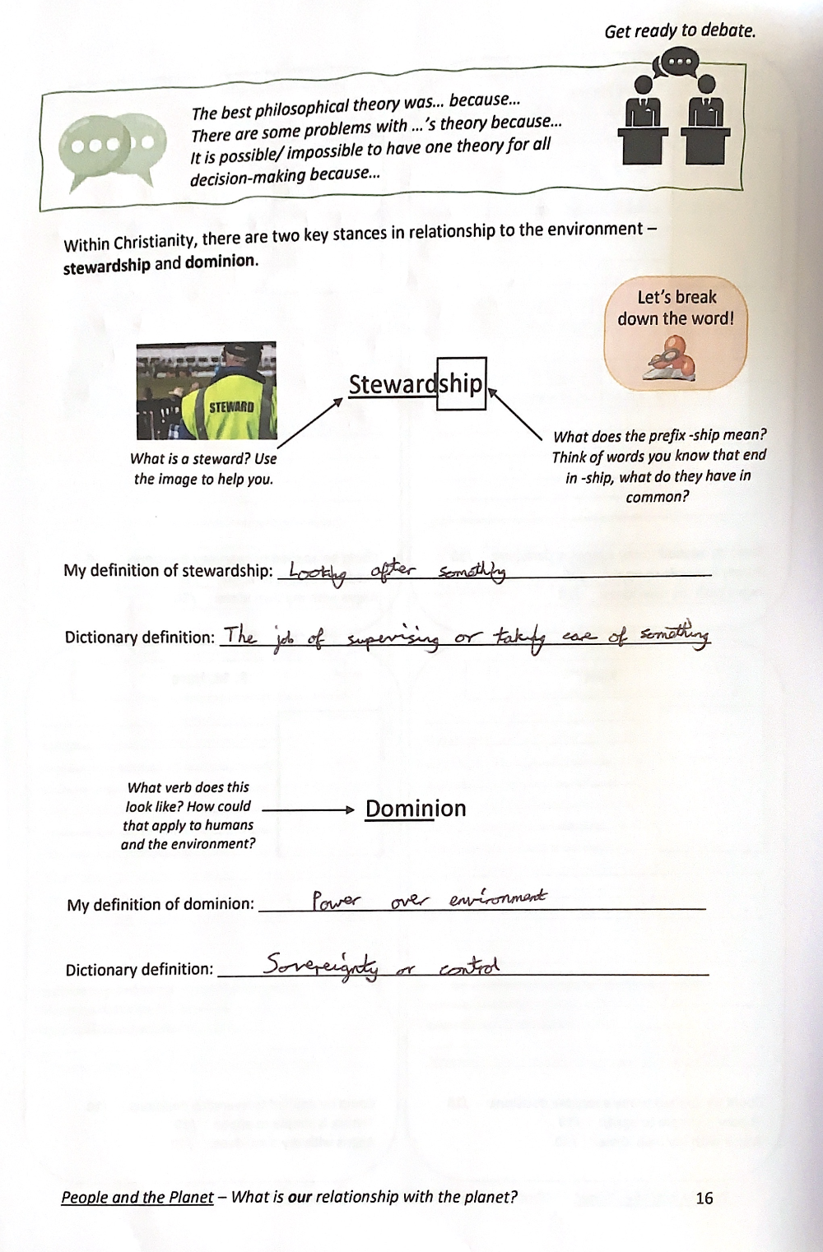
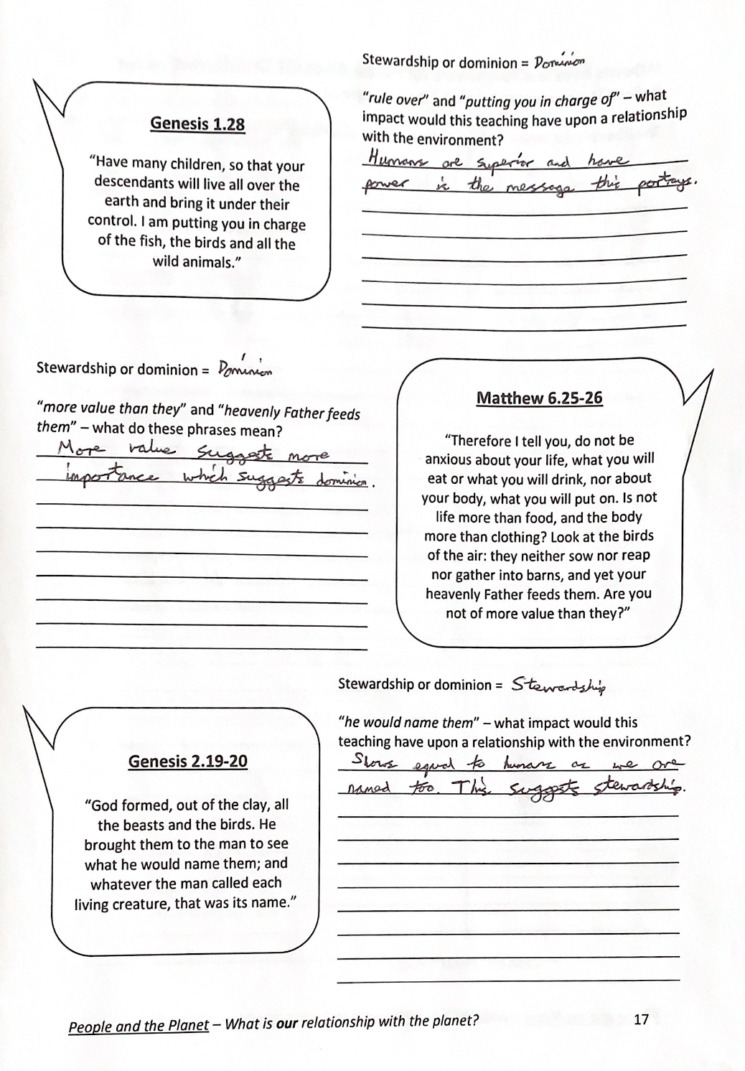
When learning specialist vocabulary, we always like break the words down to help students remember the meaning.
Students then applied this new vocabulary to extracts from scripture.

Slide 6
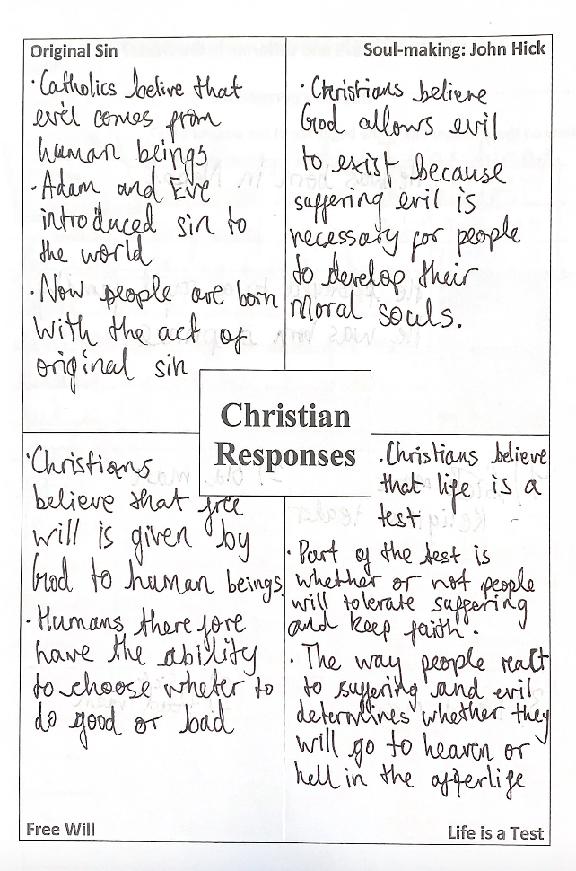
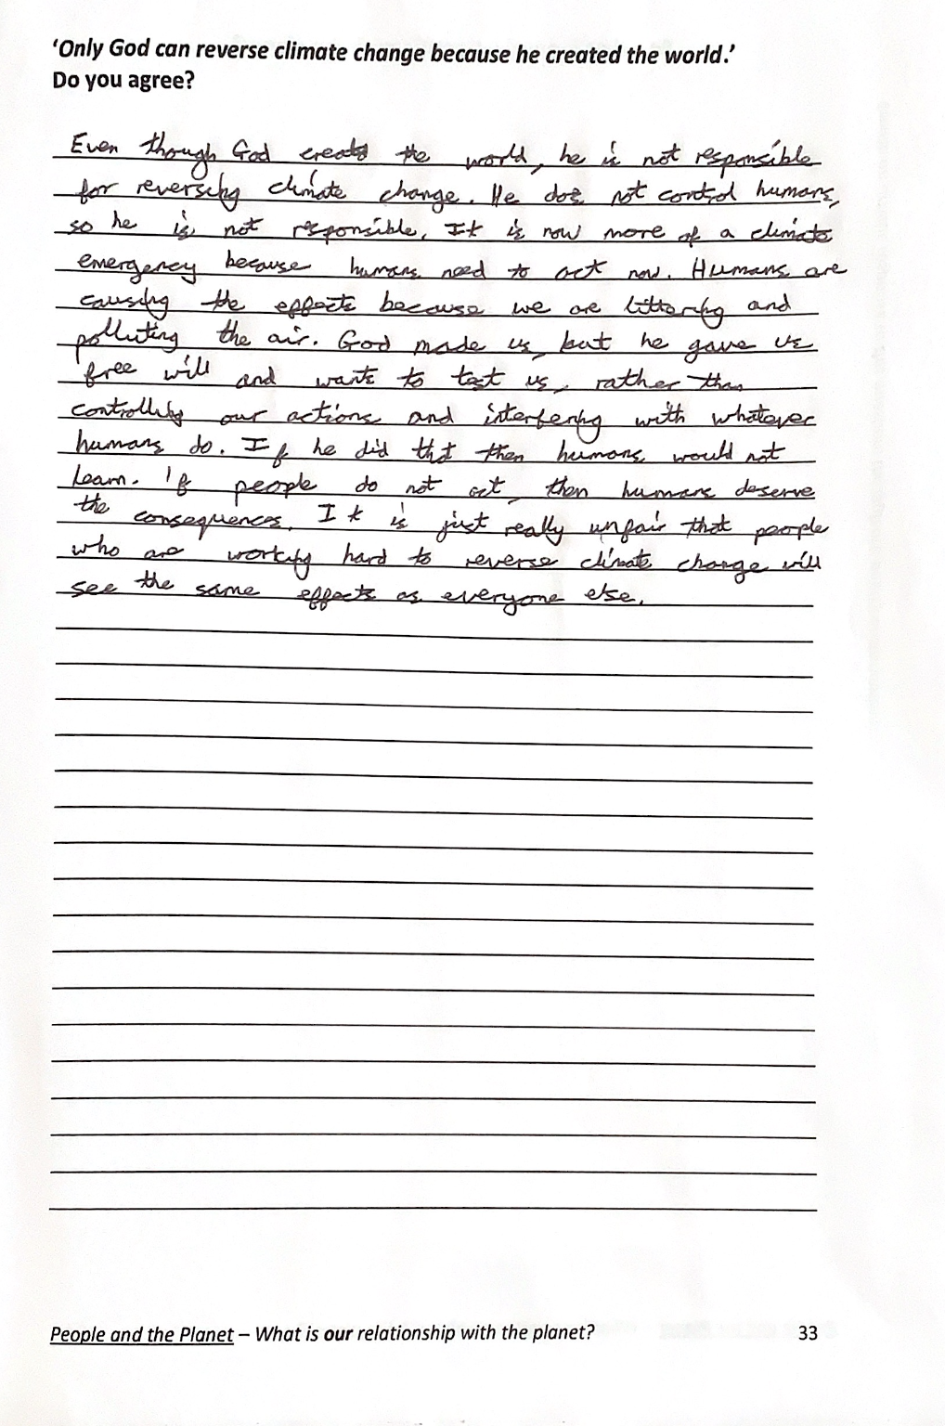
As part of the focus upon religious responses to the climate emergency, and the Problem of Evil, students complete a carousel style activity to explore four Christian responses. We emphasise the diversity within the tradition and the fact that not all Christians/ denominations share the same ideas. Homogenous is a key word that we keep using. The student work on the left-hand side had this as their feedback, and then adjusted the wording of their work.
The written response is a question about the Problem of Evil but framed from the perspective of the climate emergency.

Slide 7
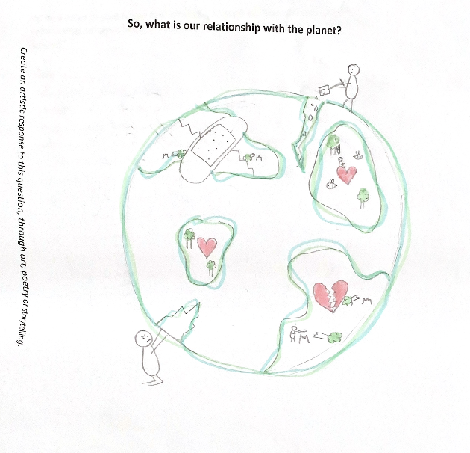
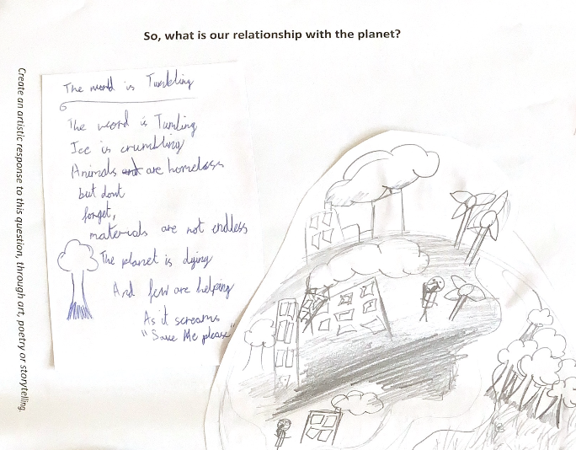
When comparing the initial drawings designed by the students and their final artistic response, it was clear that many focussed more on the unity between humans and the planets in their final response.
I selected these two responses, as the student’s poem in the first image is incredibly poignant and accompanied by a drawing showing some humans destroying the planet with factories, and others trying to save it with trees and wind turbines. The second image shows humans trying to fix the planets, by filling in the cracks, and giving the damaged earth love and a plaster.

